Slide 1

Data Science in Digital Marketing
Presented by – Sameer (B.Sc. Data Science, Sem 5)
Presented to –
Dr Aashima Bangia

Slide 2
Introduction
Digital marketing leverages online platforms to promote products/services. Data science involves extracting insights from vast datasets. Combining these fields empowers marketers to make data-driven decisions, enhance targeting, and optimize campaigns.

Slide 3
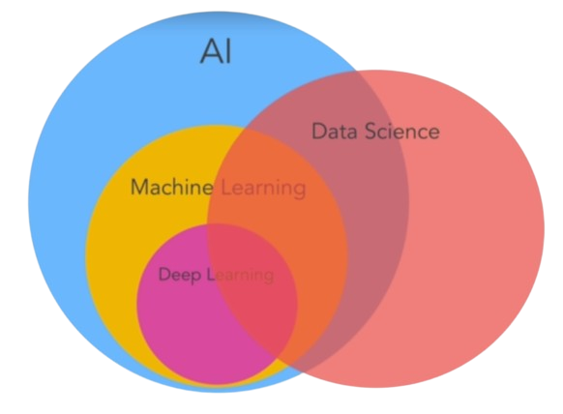
Understanding Data Science
Data science is a multidisciplinary field that employs scientific methods, processes, algorithms, and systems to extract insights and knowledge from structured and unstructured data, enabling informed decision-making and predictions.

Slide 4
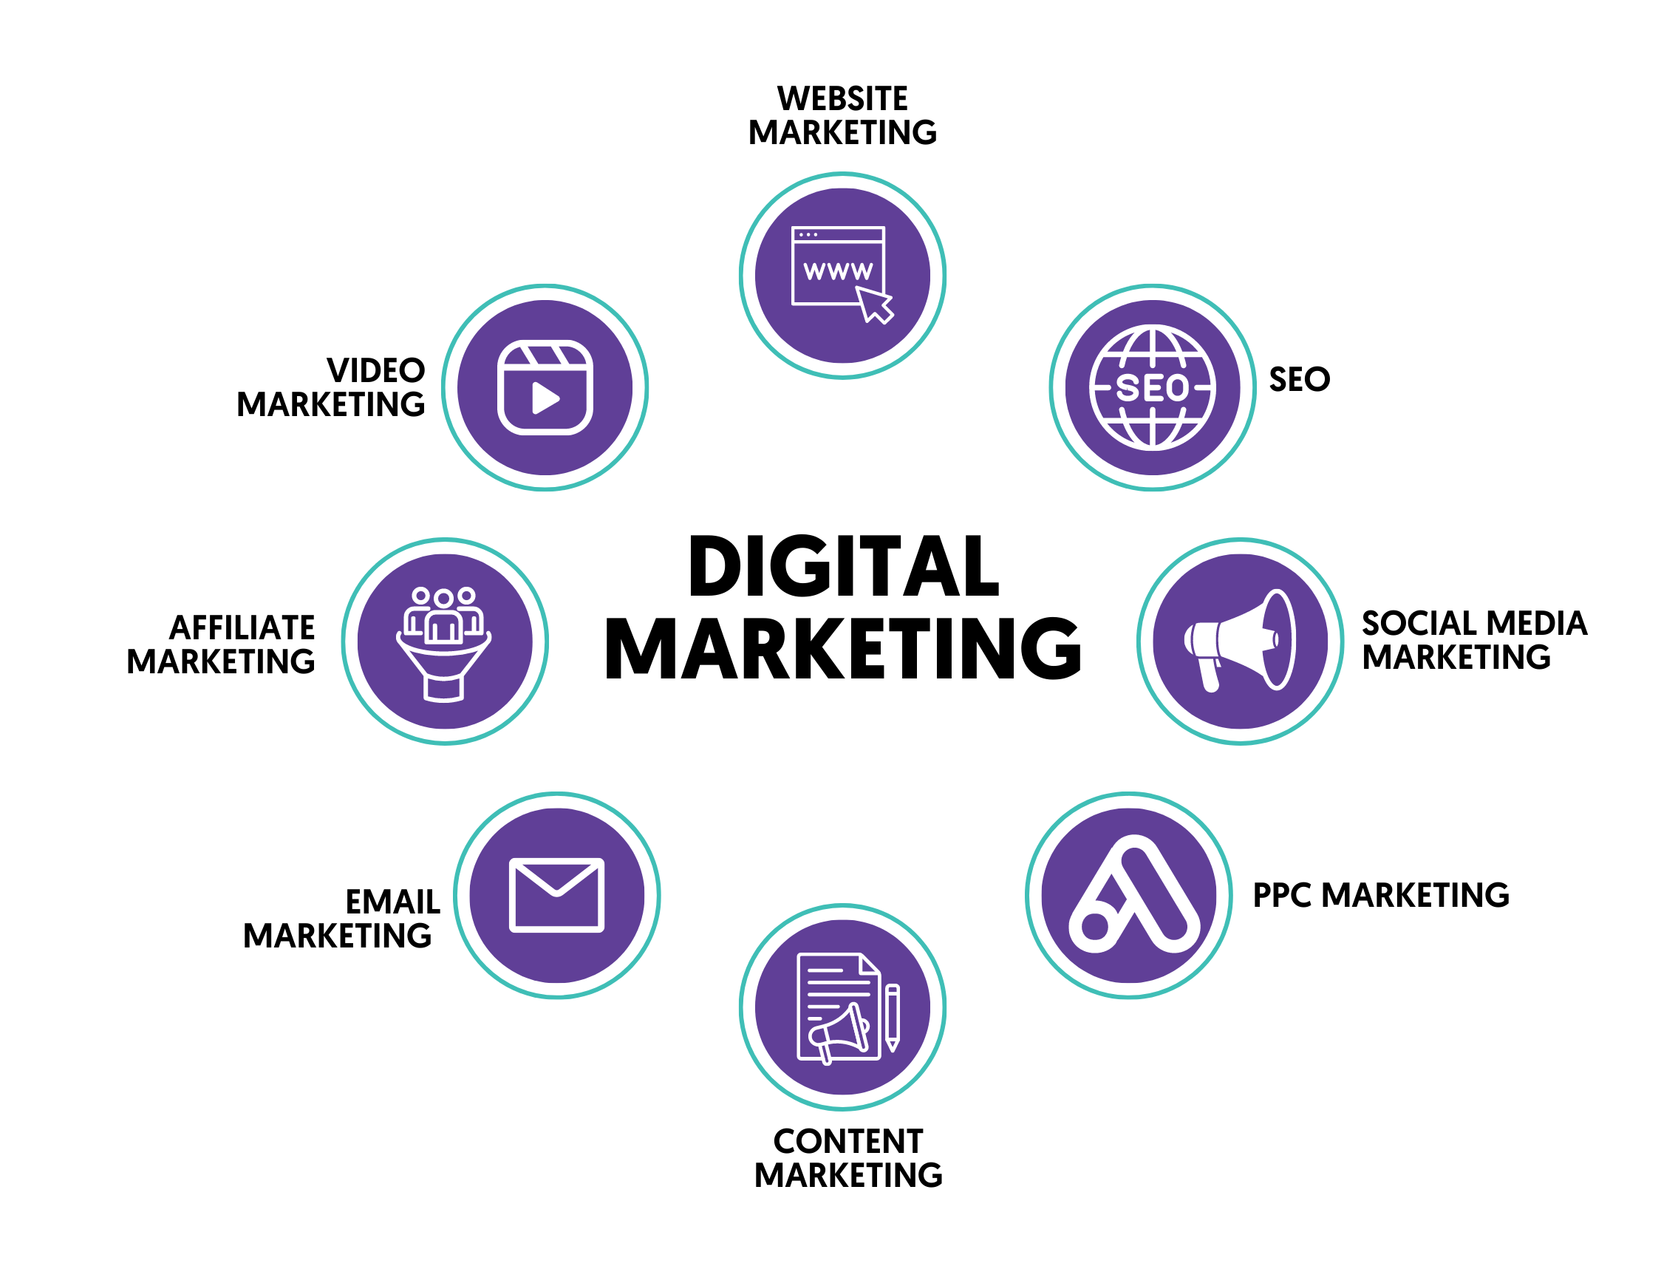
What is Digital Marketing?
Digital marketing is a strategic approach using online channels such as social media, search engines, and email to promote products or services. It encompasses various techniques to reach and engage target audiences.

Slide 5
Importance of Data in Digital Marketing
Digital marketing is crucial for businesses to reach and engage a vast online audience. It enhances brand visibility, drives targeted traffic, and facilitates meaningful customer interactions. With measurable results, it provides a cost-effective way to establish and promote a brand, ensuring competitiveness and sustained growth in the digital era.

Slide 6
Role of Data Science in Digital Marketing
Data science in digital marketing empowers businesses to make informed decisions. It analyses user behaviour, refines targeting, and optimizes campaigns for maximum impact. By extracting insights from vast datasets, data science enhances personalization, improves ROI, and enables businesses to stay agile and competitive in the dynamic digital marketing landscape.

Slide 7
Use cases of Data Science in Digital marketing

Slide 8
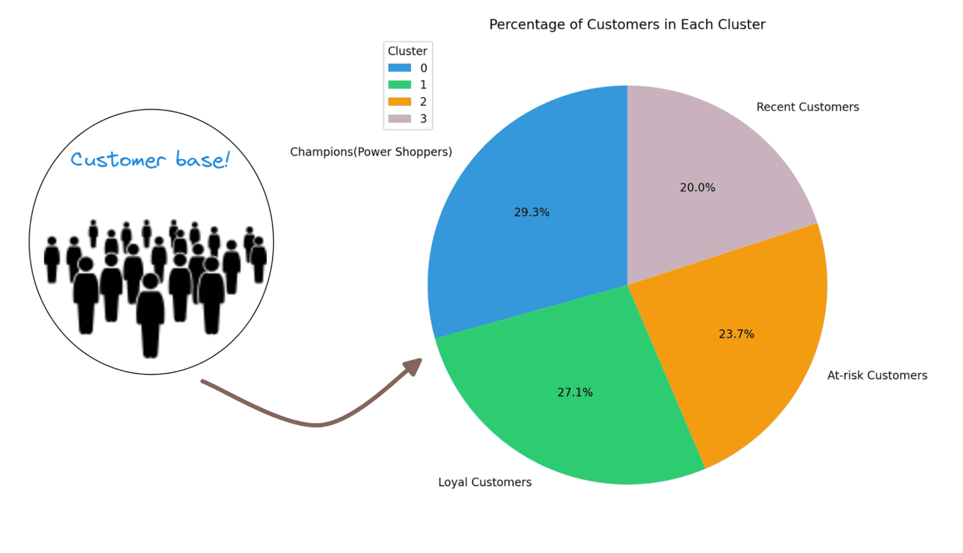
Customer Segmentation
Customer segmentation in digital marketing utilizes data science to categorize consumers based on shared characteristics and behaviours. This targeted approach enables personalized campaigns, optimizing marketing efforts, enhancing customer satisfaction, and fostering long-term brand loyalty.

Slide 9

Personalization and Targeting
Data science enables personalized marketing by analysing user behaviour, preferences, and demographics, resulting in targeted and relevant content.

Slide 10
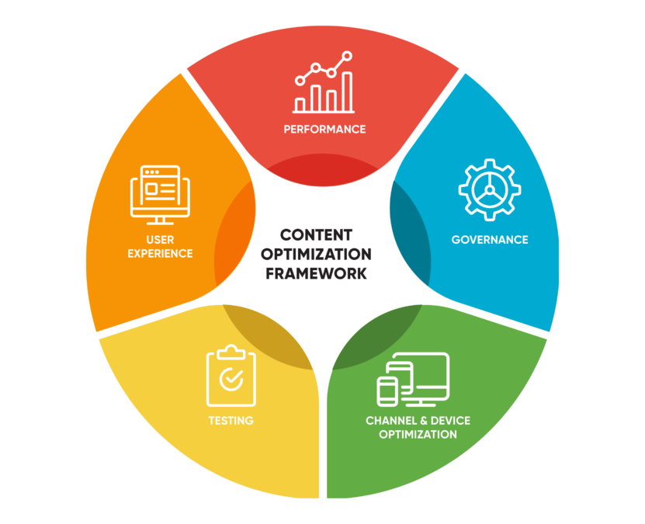
Content Optimization
Content optimization in digital marketing utilizes data science to analyse user behaviour, preferences, and trends. By tailoring content based on insights, businesses enhance relevance, engagement, and overall effectiveness of their campaigns.

Slide 11
Predictive Analytics
Predictive analytics in digital marketing employs data science to forecast future trends, consumer behaviour, and campaign performance. By leveraging historical data, businesses make informed decisions, enhancing targeting precision and optimizing strategies for maximum effectiveness in the ever-evolving digital landscape.

Slide 12
Real-Time Campaign Optimization
Real-time campaign optimization in digital marketing employs data science to analyse live data, adjusting strategies instantly. It enhances targeting precision, maximizes engagement, and ensures campaigns align with dynamic market trends. This agile approach boosts efficiency and effectiveness, yielding optimal results in real-time.

Slide 13

Case Study

Slide 14
Amazon's Data-Driven Digital Marketing
Amazon, a global e-commerce giant, leverages data science to optimize digital marketing strategies. Through predictive analytics, Amazon tailors personalized recommendations, improving customer engagement. Machine learning algorithms analyse user behaviour, enhancing targeted advertising. This data-centric approach enables Amazon to stay ahead in the dynamic landscape of digital marketing.

Slide 15
Driving Success with Data Science
Amazon's data science applications extend to dynamic pricing, ensuring competitiveness. Predictive models analyse market trends, allowing strategic inventory management. A/B testing refines marketing campaigns, maximizing effectiveness. By harnessing the power of data, Amazon pioneers innovation in digital marketing, achieving unparalleled customer satisfaction and sustained market leadership.

Slide 16
Challenges and Ethical Considerations
The challenges of utilizing data science in digital marketing include ensuring data privacy and security, navigating the evolving regulatory landscape, and addressing the need for skilled professionals. Balancing the ethical use of data while extracting meaningful insights poses an ongoing challenge in harnessing the full potential of digital marketing strategies.

Slide 17
Conclusion
Data science revolutionizes digital marketing by enabling precise targeting, personalization, and predictive analysis, driving effective and efficient marketing strategies.

Slide 18
THANK YOU

